Slide 1
Musical super matrix
Team 7

Slide 2
Table of contents
01
02
03
04
Background
Objective
Materials and Methods
Hardware Implementation

Slide 3
01
Introduction

Slide 4
Background
Many diseases cause hand dysfunction
Traditional methods are boring
Can’t keep going without motivation
A lot of time needed

Slide 5
02
Objective

Slide 6
Objective
Finger Dexterity
Hand-Eye Coordination
Grasp & Release Ability
Improve Fine Motor Functions

Slide 7
Objective
1
2
3
Hardware game aids war injury recovery
Enhances hand function and cognitive skills
Empowers players in their rehab journey for well-being and control.

Slide 8
03
Materials and Methods

Slide 9
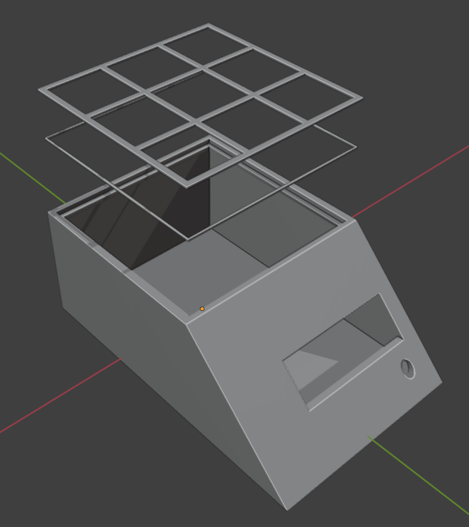
Materials and Methods
3D printed casing
3D printed layout for the 3x3 matrix system, ensuring proper placement of components.

Slide 10
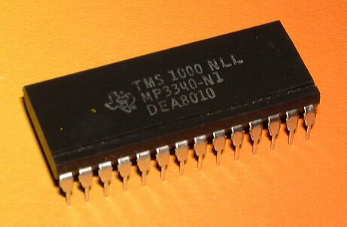
Materials and Methods
Microcontroller Unit
● Microcontroller Unit (MCU),
A Program, to count when magnet reaches target cell, signifying successful movement.

Slide 11
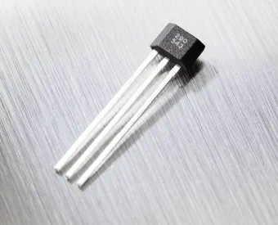
Materials and Methods
Hall effect sensor
Hall effect sensors within the matrix to detect movement of the magnetized piece.

Slide 12
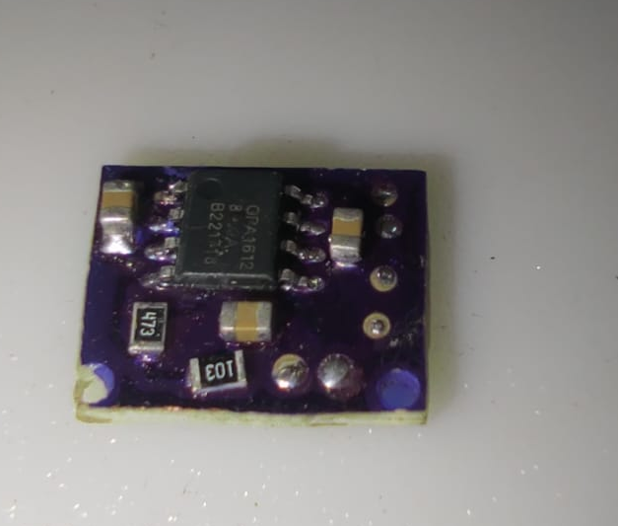
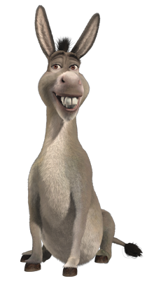
Materials and Methods
Printed circuit board (PCB)
For sound amplification
We made by ourselves
Exclusively sold by Mohamed Salah

Slide 13
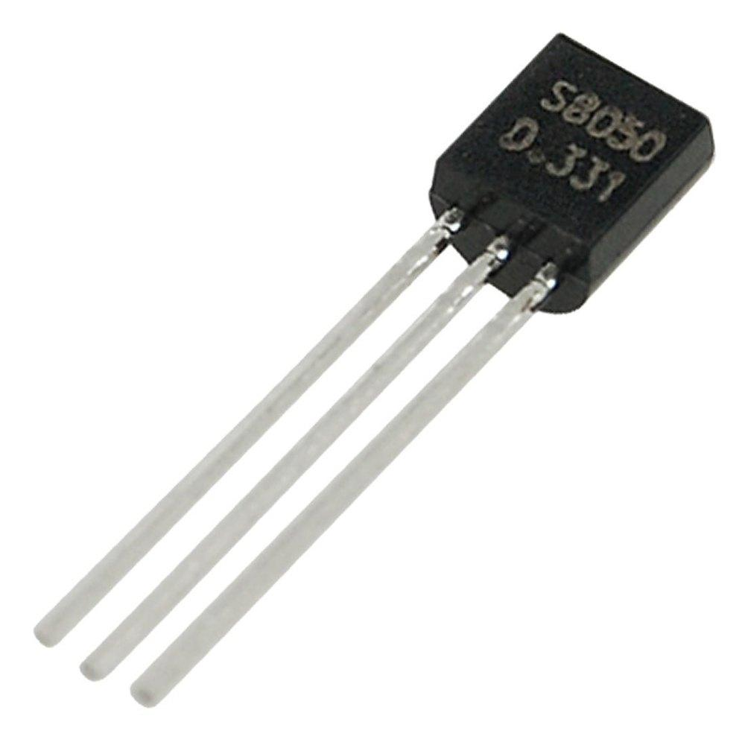
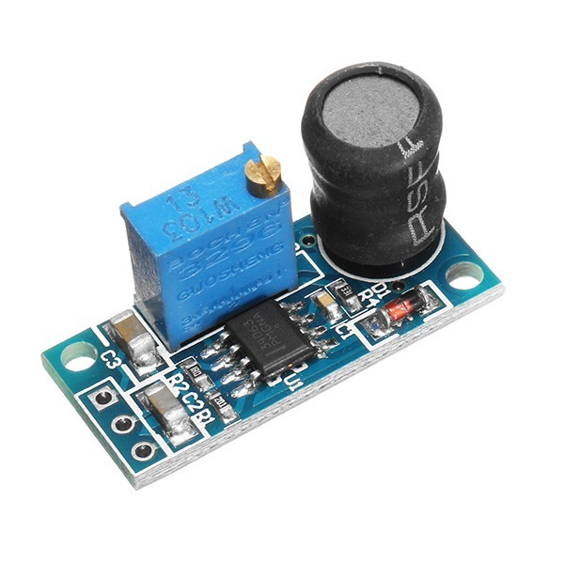
Materials and Methods
To raise the voltage from 5v to 9v for better led illumination
Transistors
Boost Converter

Slide 14
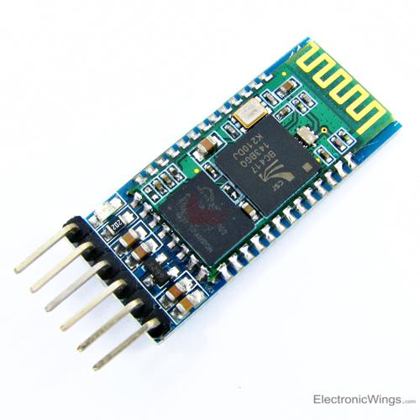
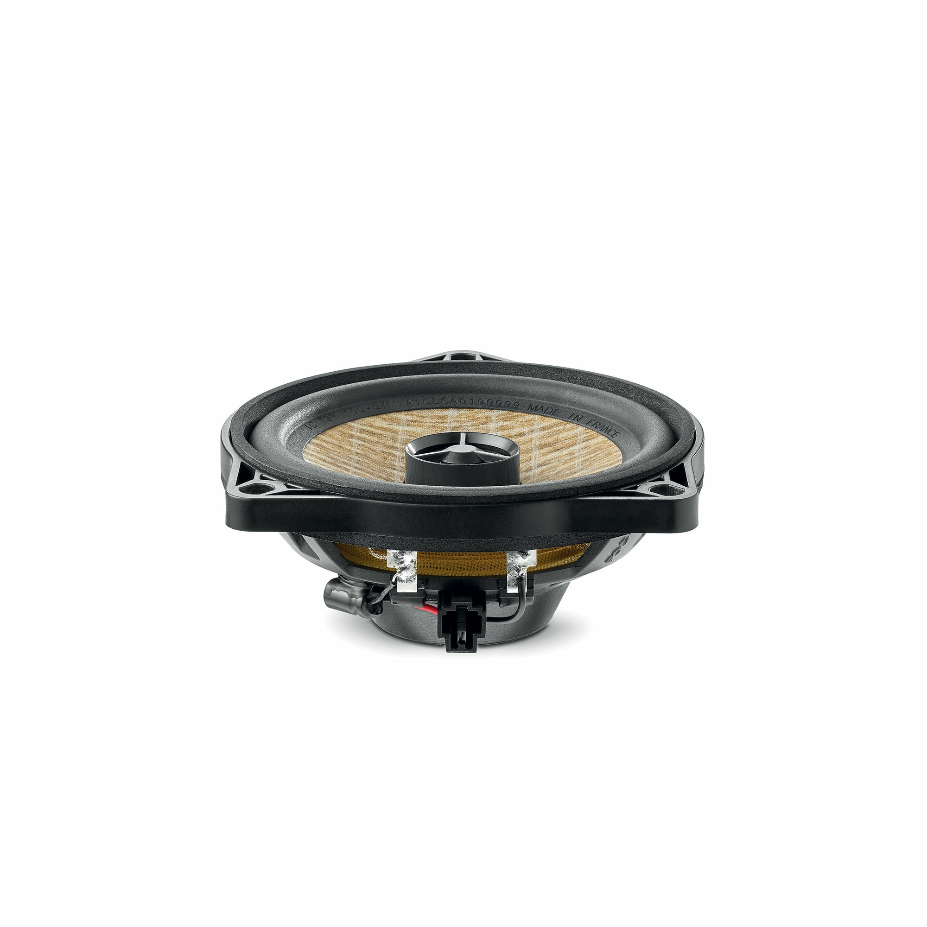
Materials and Methods
Bluetooth module
Speakers

Slide 15
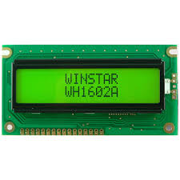
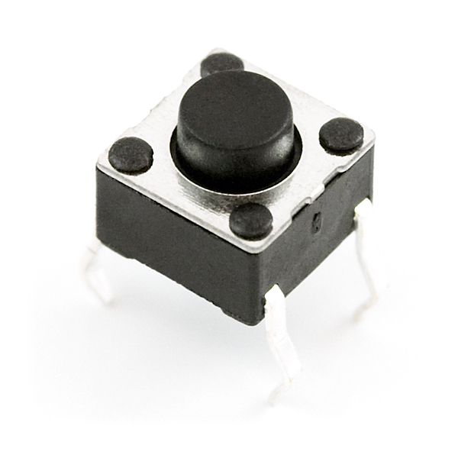
Materials and Methods
LCD
Push Button

Slide 16
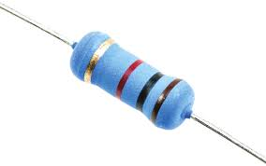
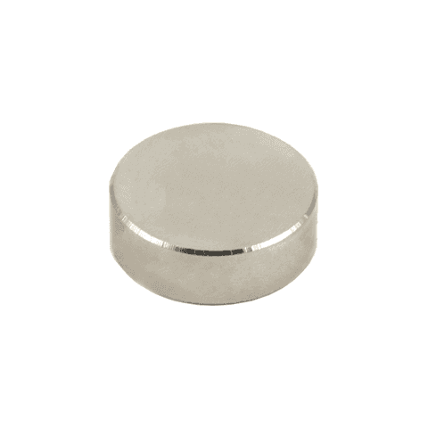
Materials and Methods
Resistors
Magnet

Slide 17
04
Hardware Implementation

Slide 18
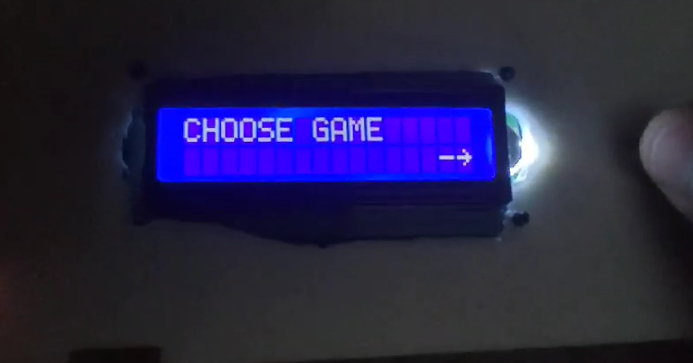
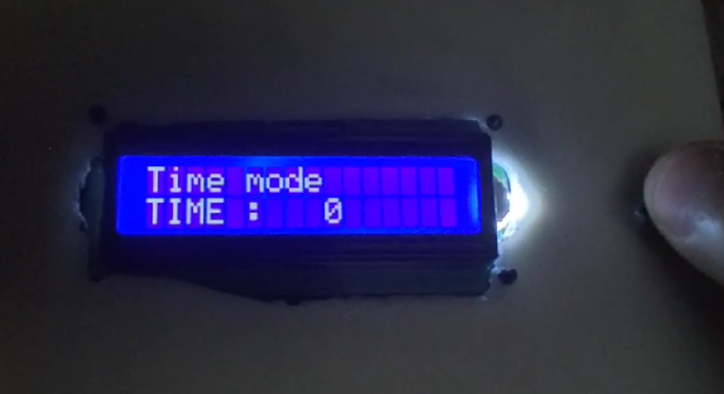
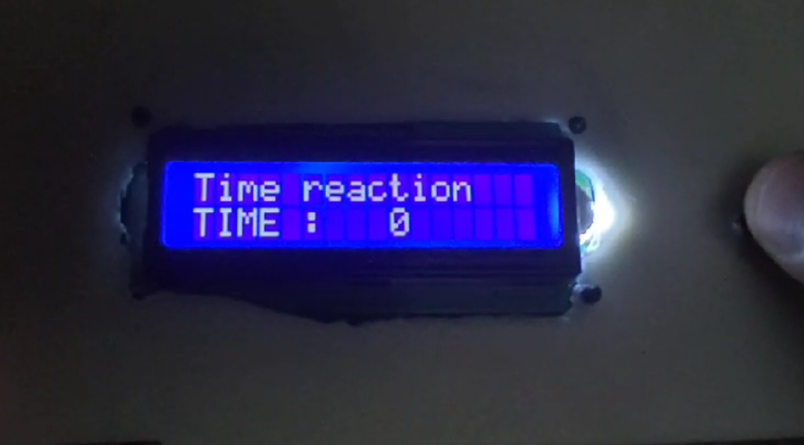
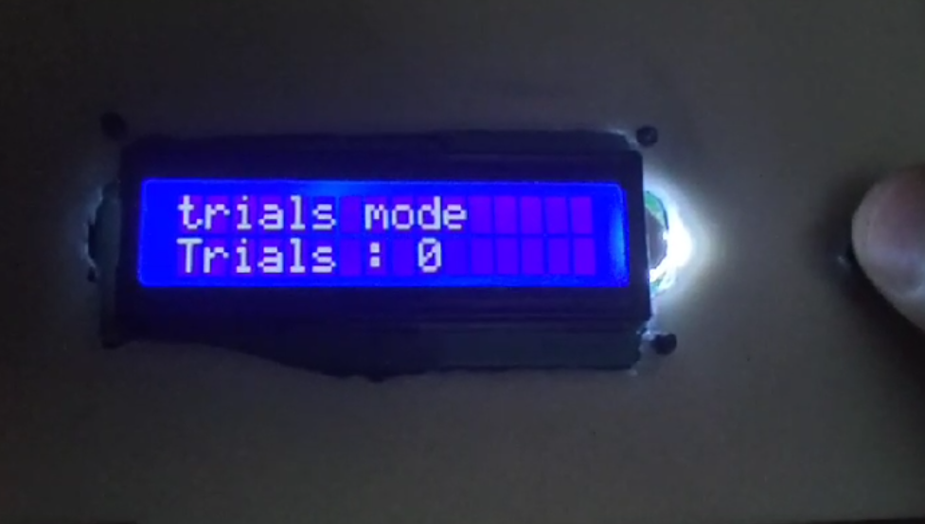
User Modes

Slide 19
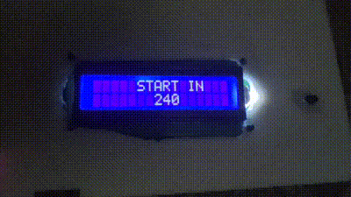
Preview

Slide 20
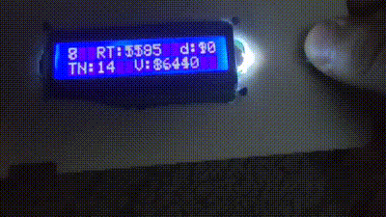
Preview
RT : Reaction time (ms)
D : Distance (cm)
TN : Total Number
V : Velocity (cm/s)

Slide 21
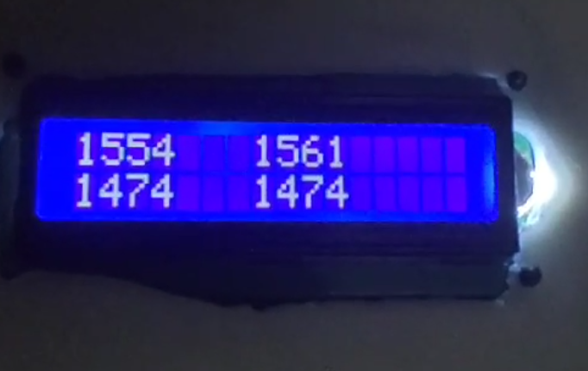
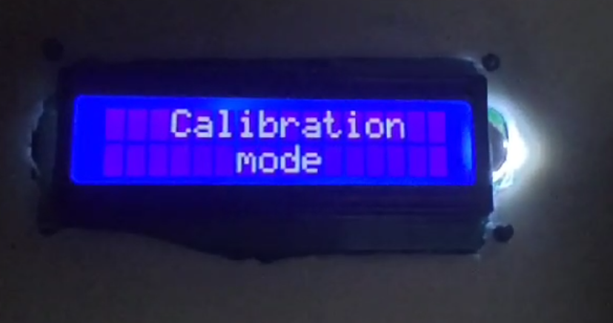
Service Modes
Stored Value Mode
Calibration Mode
It retrieves value stored within the dedicated memory chip on device, diagnoses potential memory-related errors during gameplay.
It focuses on sensor data acquisition, gathers all sensor readings and calculates the average value.

Slide 22
Thanks
Do you have any questions?

